Slide 1
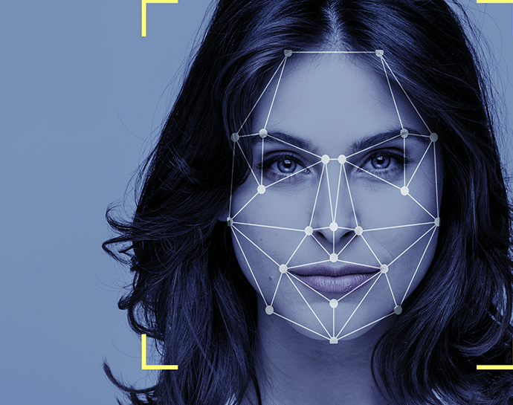
AttendanceEye Facial Recognition Using Generative Ai
By:
Mohsin Ali Mirza – 20k-0353
Waleed Gul – 20k-0259
Mehwish Sameer- 20k - 1085

Slide 2
Acknowledgement
Dr Muhammad Waqas (Supervisor)
Dr Muhammad Rafi (Co-Supervisor)

Slide 3






Table Of Contents
Dataset Collection
Face Detection
Face Recognition
Results
Research

Slide 4


Slide 5
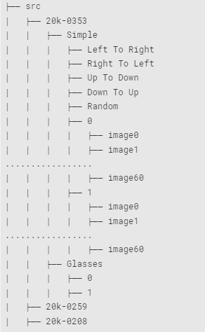





Dataset Collection – Total Hierarchy
Down To Up
Students = 100 5 Actions
Frames in 1 Action = 60
Total Frames Actions = (5*60) = 300
Experiment Repeated = 2*300 = 600
Total Images = *100 = 600 images
Left To Right
Random
Right To Left
Up To Down

Slide 6
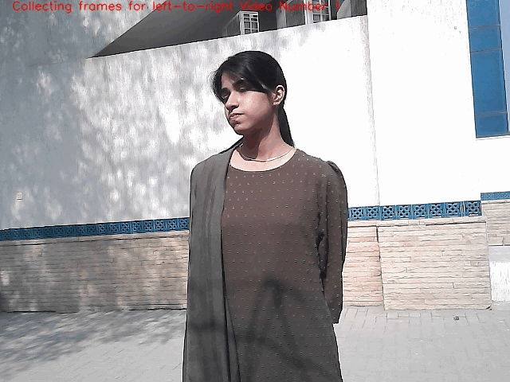
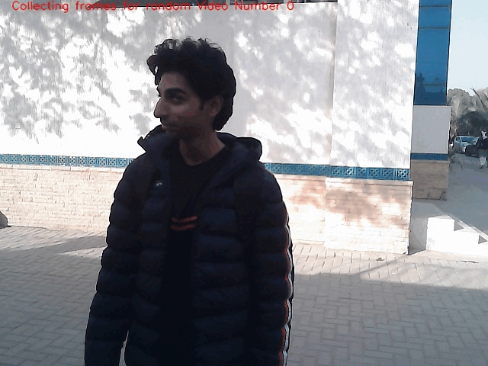
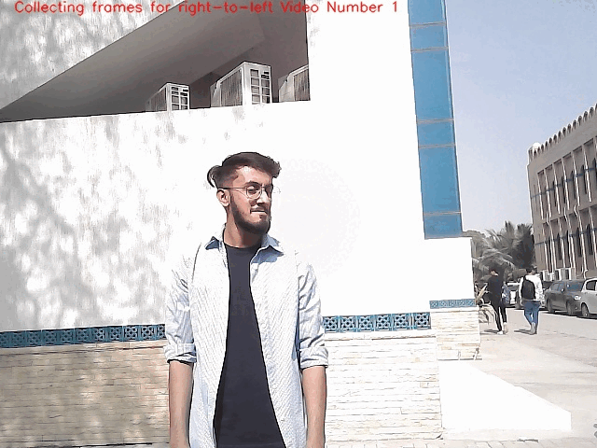
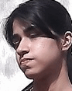
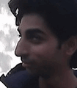

Dataset Preparation
Left To Right
Random
Right To Left

Slide 7

Face Detection

Slide 8
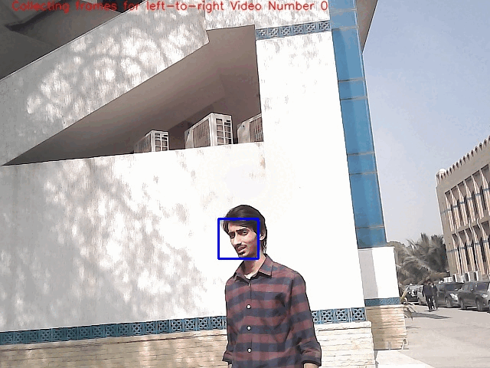
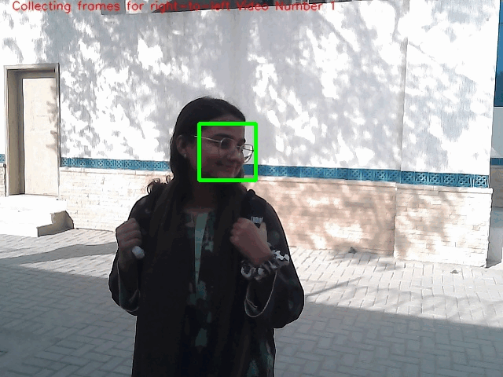
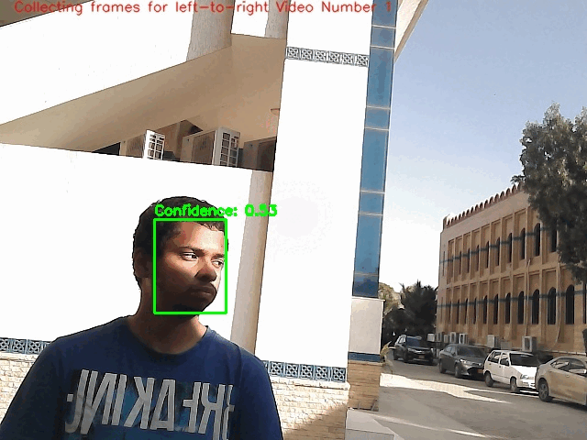
Face Detection – Real Life
Yolo v8
Open CV
Dlib

Slide 9


Slide 10
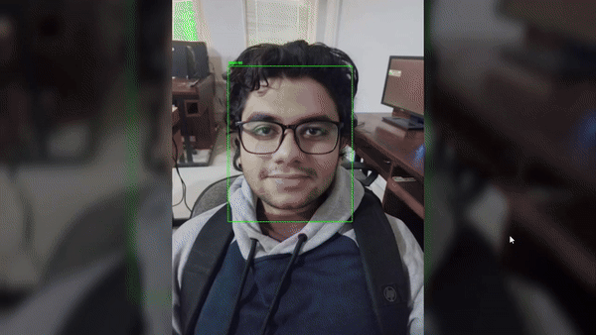
Face Recognition - With Yolov8 - Photos

Slide 11
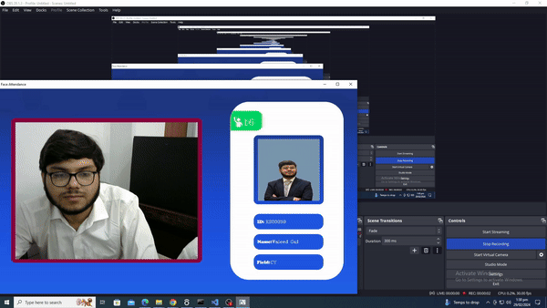
Face Recognition – Real Life

Slide 12
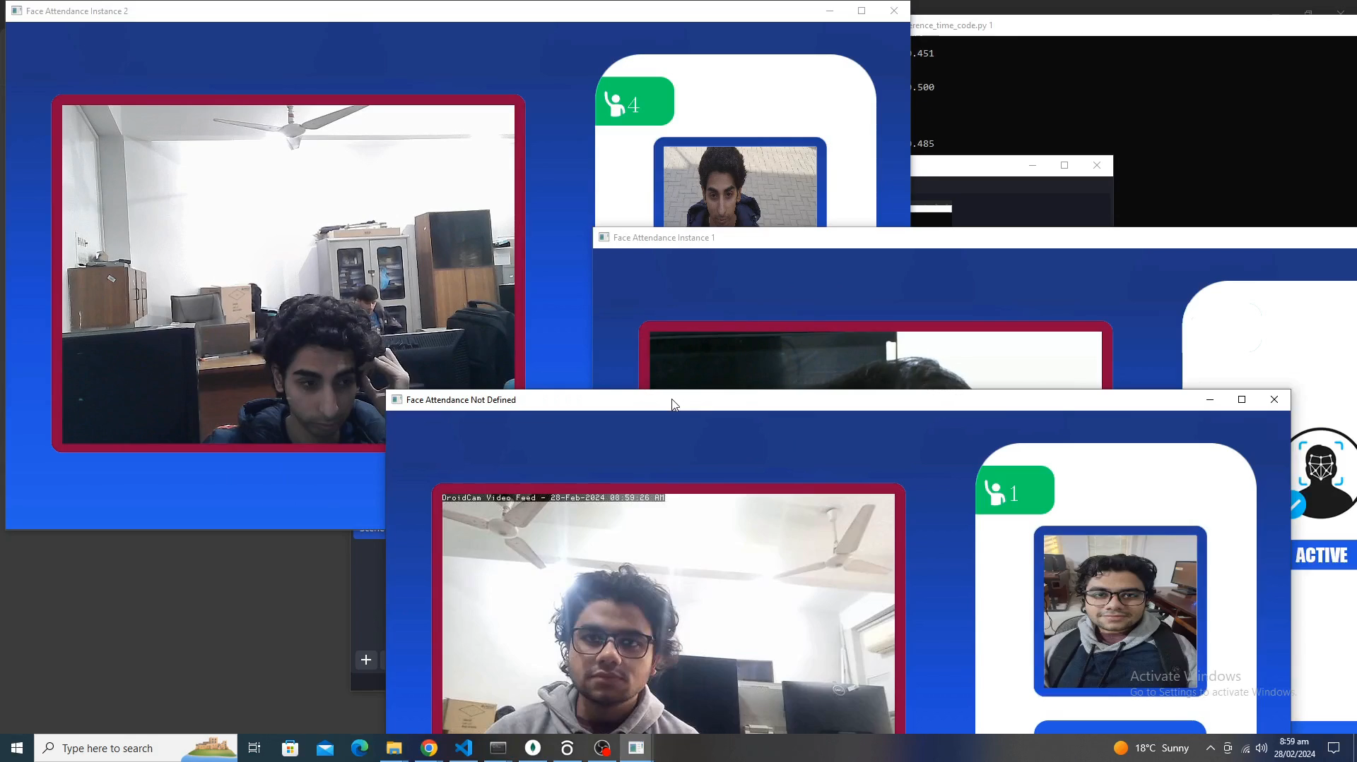
Multiple Camera Inference – Real Life

Slide 13
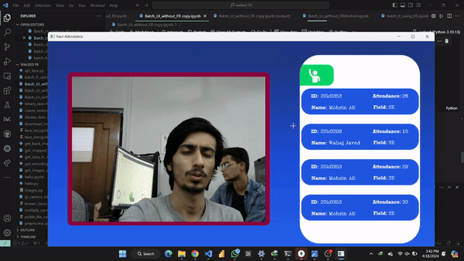
Batch Face Inference – Real Life

Slide 14
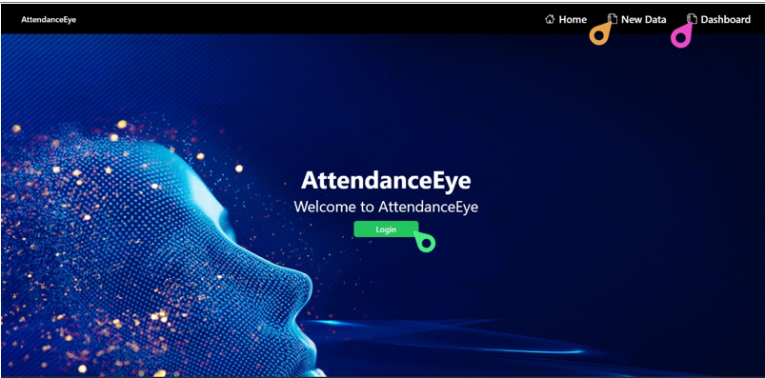
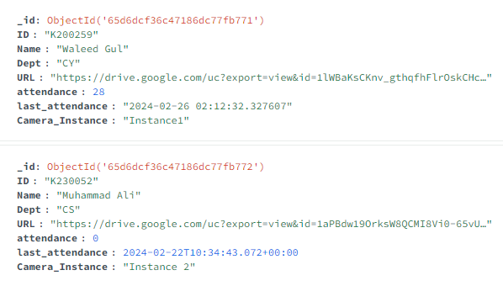
Frontend & Database Connection
Database
Frontend

Slide 15

Results

Slide 16
Results – Confusion Matrix
Model | Actual Person | Not Actual Person
Algorithm Predicts Person | Algorithm correctly identifies a Person in Database | Algorithm incorrectly identifies the Person with someone else in Database
Algorithm Does Not Detect Person | Algorithm fails to identify a Person who is present in the Database | Algorithm correctly does not identify a Person where there is none in Database
Model | Actual Person | Not Actual Person
Algorithm Detects Person | TP | FP
Algorithm Does Not Detect Person | FN | TN

Slide 17
Face Detection – Evaluation Metrics
Model | Accuracy | Precision | Recall | F1-Score
Yolov8 | 0.968604365 | 0.987970977 | 0.979616306 | 0.983775904
Dlib | 0.506839378 | 0.999565311 | 0.491556220 | 0.659024145
Open-CV | 0.297493667 | 0.344616351 | 0.666666666 | 0.454361894

Slide 18
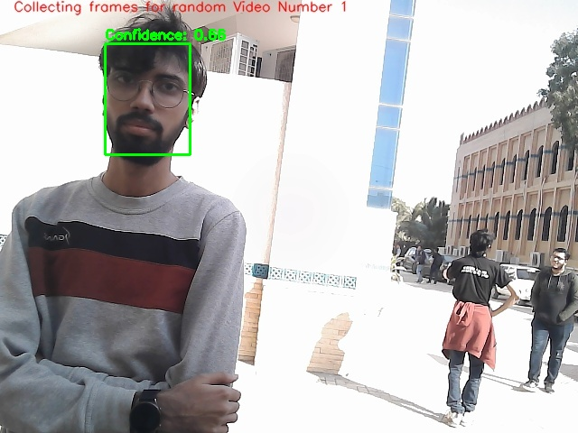
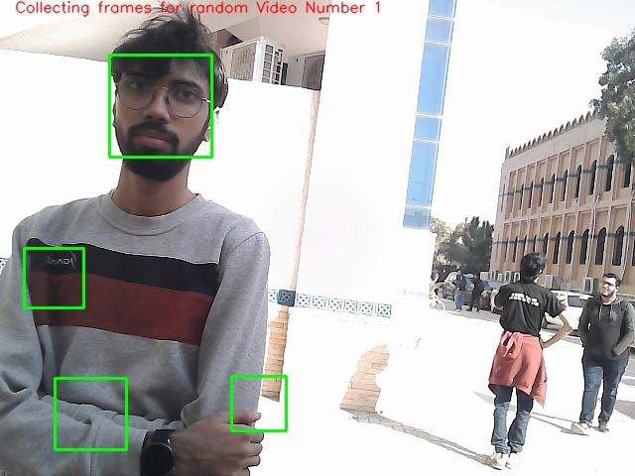
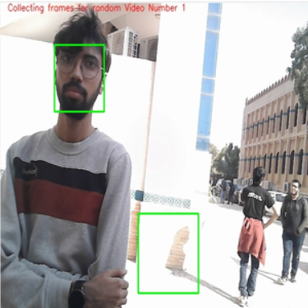
Face Detection - Comparison
Yolov8 True Positive
OpenCV False Negative
Dlib False Positive

Slide 19
Face Recognition – Evaluation Metrics
Model | Accuracy | Precision | Recall | F1-Score | Best | Avg | Worst
FR With Yolo | 0.77777 | 0.6333333 | 0.699999 | 0.666666 | 0.11 | 0.42122 | 0.6
FR Without Yolo | 0.77777 | 0.55 | 0.444 | 0.48 | 7.4 | 10.24 | 19.4
Deepface Without Yolo | 0.6 | 0.59 | 0.55 | 0.57 | 2.05 | 2.89 | 3.31
Deepface With Yolo | 0.58 | 0.56 | 0.38 | 0.42 | 9.2 | 19.0 | 21.5

Slide 20
Multiple Camera – Inference Time
Try | Face Recognition |  | Database | Marked
 | Best | Worst | Average | Best | Worst
1st | 0.34 | 0.38 | 2.8 | 0.07 | 0.38
2nd | 0.315 | 0.33 | 3.121 | 0.31 | 0.36
3rd | 0.317 | 0.346 | 3.786 | 0.07 | 0.32
Average | 0.324 | 0.352 | 3.24 | 0.15 | 0.35

Slide 21
Batch Face Recognition – Evaluation Metrics
Model | Accuracy | Precision | Recall | F1-Score
Face Recognition | 0.64 | 0.71 | 0.84 | 0.76
Batch Inception | 0.6 | 0.5 | 0.75 | 0.76
Model | Best Time | Average Time | Worst Time
Face Recognition | 0.0215523 | 0.01052474 | 0.0332157611
Batch Inception | 0.139792204 | 0.179710484 | 0.27211154

Slide 22
Optimizations
Model | Best Time | Average Time | Worst Time
Without UI | 0.0215523 | 0.01052474 | 0.0332157611
With UI | 0.0271295 | 0.1515293 | 0.0366699695
Model | First Time | Next Time
With Cache | 0.0342266559 | 0.0000001
Without Cache | 0.025386484 | 0.0285738

Slide 23
Overall Model - Results
Model | Best Time | Average Time | Worst Time
Face Recognition Optimized | 0.87 | 1.16 | 1.376
Face Recognition Without Optimized | 0.0271295 | 0.1515293 | 0.0366699695

Slide 24

Generative AI

Slide 25
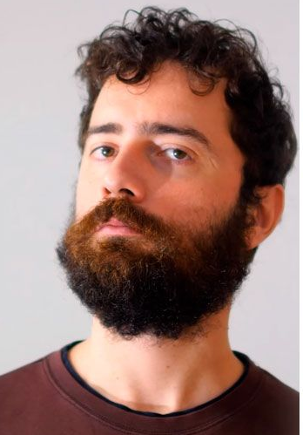
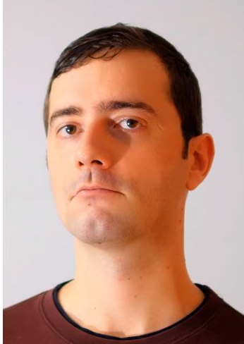
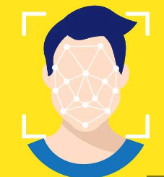

Most Common Pitfall
✅

Slide 26
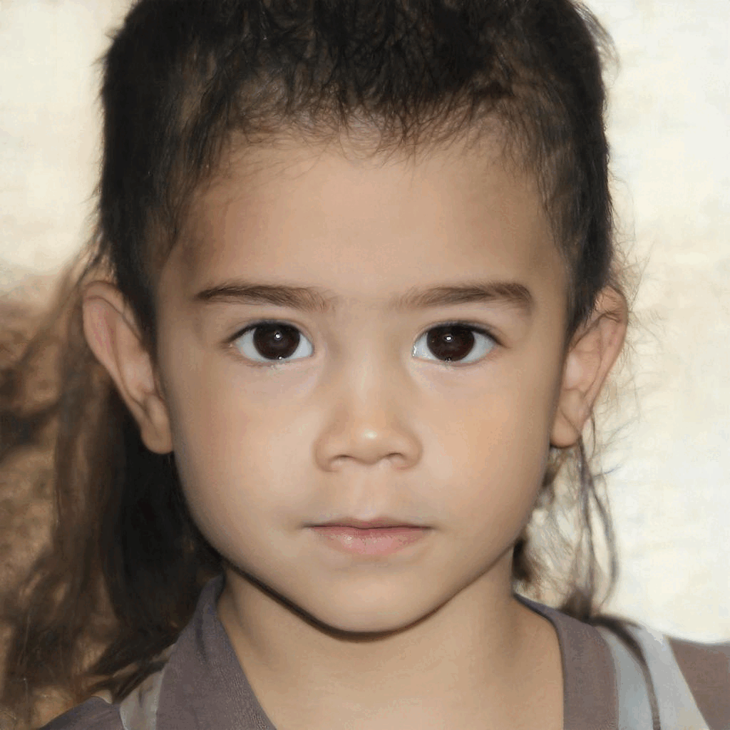
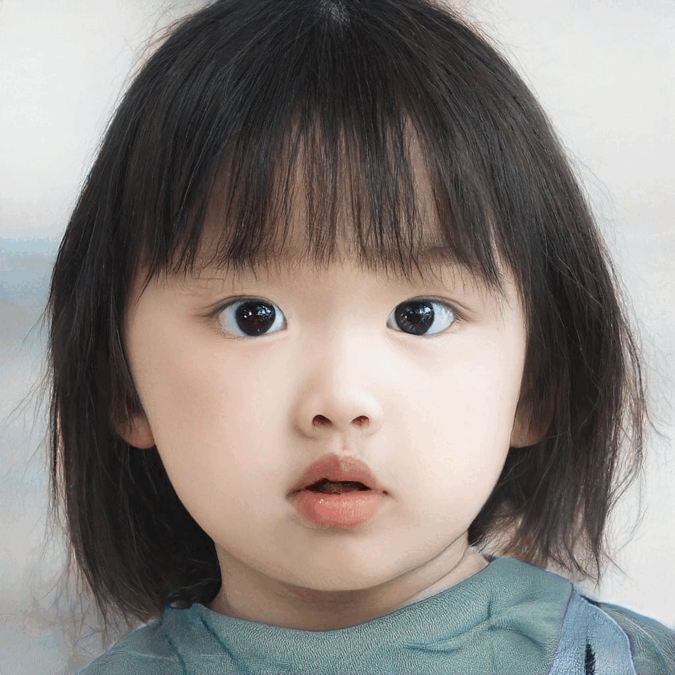
Interface GANS

Slide 27
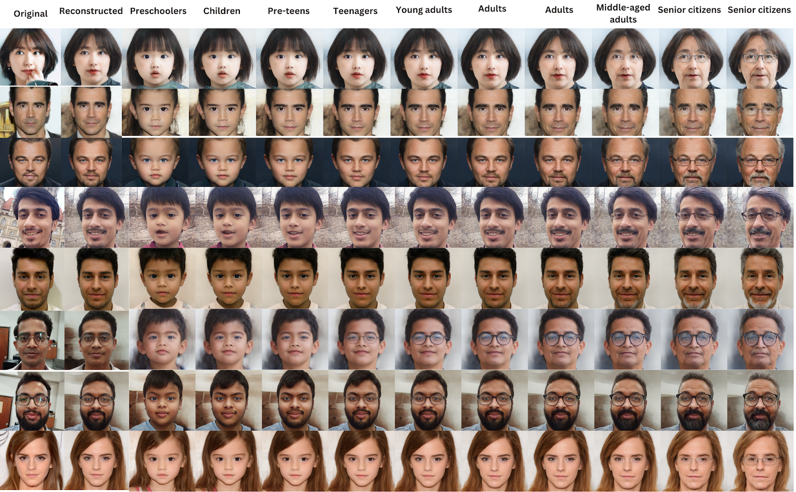
Interface GANS

Slide 28
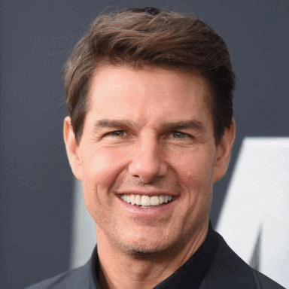

Attribute Gan

Slide 29
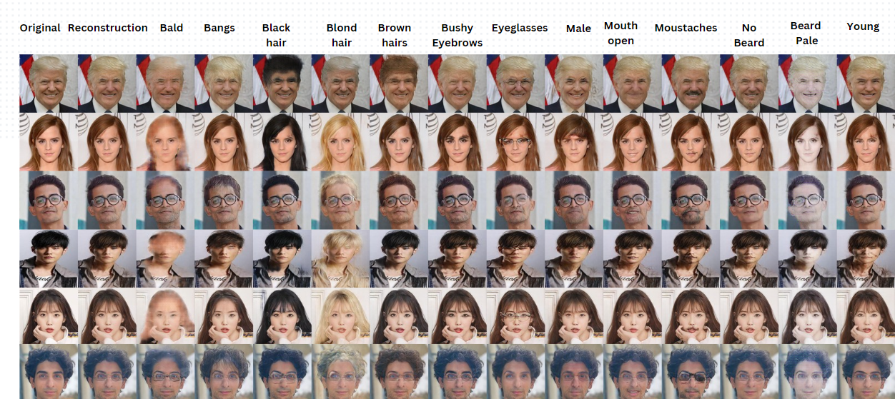
Attribute GANS

Slide 30
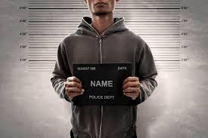
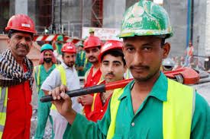
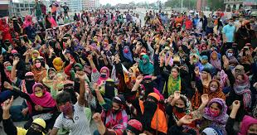
Real Life Applications
Crime Scenes
Constructor Workers
Garment Companies

Slide 31

Any Questions?

Slide 32


